Slide 1
A Brief History of the Internet
Alan Dewar
2023-06-27

Slide 2
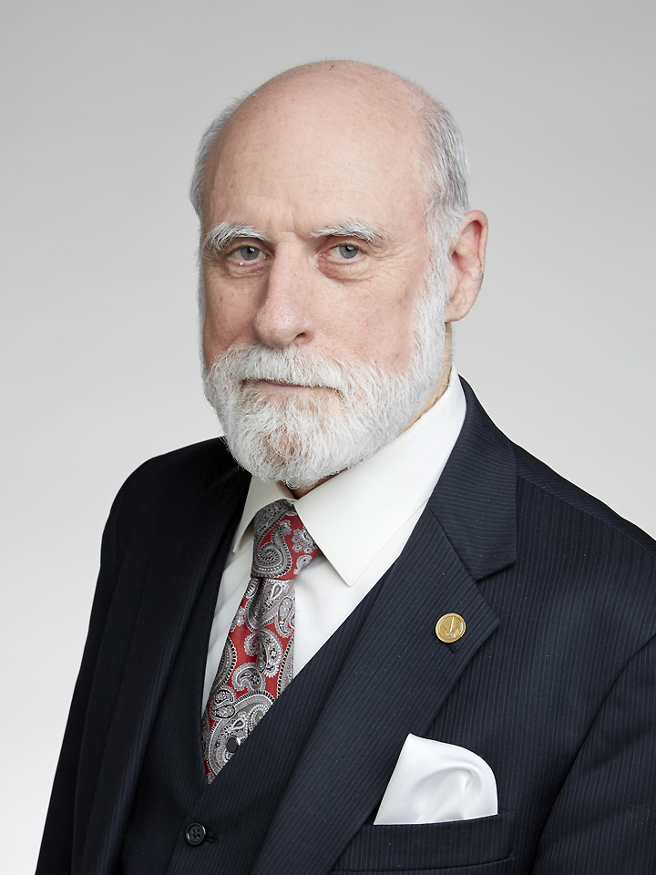
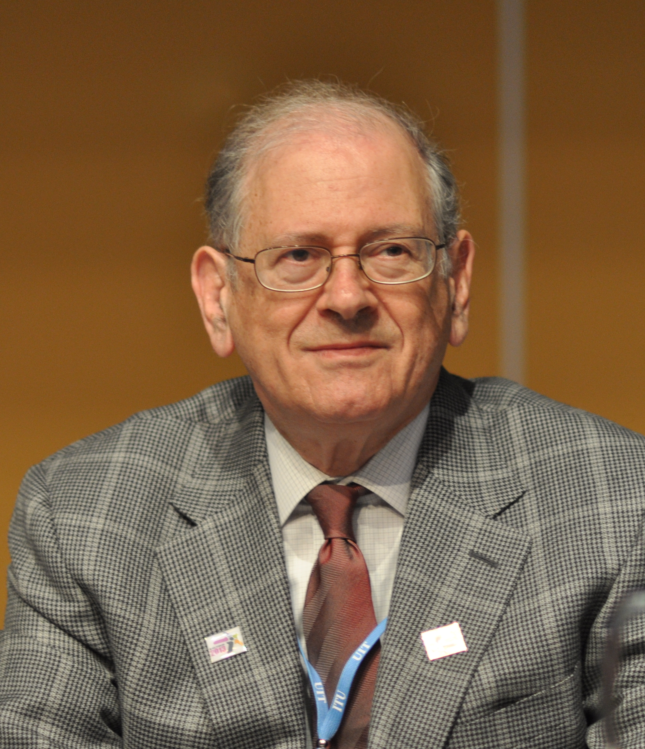
Fathers of the Internet
Vint Cerf and Bob Kahn

Slide 3
Vint Cerf
History
Born June 23, 1943 (Happy 80th birthday!)
1972: Ph.D., University of California, Los Angeles
1972 – 1976: Stanford assistant professor, CS & EE
1973 – 1982: Defense Advanced Research Projects Agency (DARPA)
  Developed TCP/IP protocols, with Bob Kahn
1982 – 1986: VP, MCI Digital Information Services
  MCI Mail: first commercial email service connected to Internet
1986: VP, Corporation for National Research Initiatives (CNRI)
1992: Launched Internet Society, with Bob Kahn et al.
1992: IETF Internet Architecture Board
1994: MCI senior VP for data architecture
1998: Internet Corporation for Assigned Names and Numbers (ICANN)
  2000 – 2007: Chairman

Slide 4
Vint Cerf
Today
2005: Vice President and Chief Internet Evangelist, Google
Suggested title “archduke”
  Nixed: negative connotations
Job interview
  Email to Google CEO Eric Schmidt: “Hi Eric, would you like some help?”
  Schmidt’s reply: “Yes.”

Slide 5
Vint Cerf
Awards
IEEE Alexander Graham Bell Medal (1997)
National Medal of Technology (1997)
Marconi Prize (1998)
ACM Turing Award (2004)
Presidential Medal of Freedom (2005)
Japan Prize (2008)
Queen Elizabeth Prize for Engineering (2013)
IEEE Medal of Honor (2023)

Slide 6
Bob Kahn
History
Bolt Beranek and Newman (BBN)
  contracted by U.S. ARPA to build switches for ARPANET
1972 – 1985: Defense Advanced Research Projects Agency (DARPA)
  Developed TCP/IP protocols, with Vint Cerf
1986: founded the Corporation for National Research Initiatives (CNRI)
  Remains its chairman, CEO and president
1992: Launched Internet Society, with Vint Cerf et al.

Slide 7
Bob Kahn
Awards
Marconi Prize (1994)
National Medal of Technology and Innovation (1997)
IEEE Alexander Graham Bell Medal (1997)
Presidential Medal of Freedom (2005)
Japan Prize (2008)
Queen Elizabeth Prize for Engineering (2013)

Slide 8
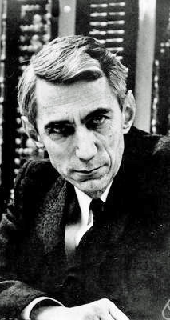
Claude Shannon
Father of modern information theory
1948: “A Mathematical Theory of Communication”
Cryptanalysis for national defense of the United States during World War II
Fundamental work on codebreaking and secure telecommunications

Slide 9
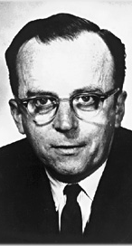
J.C.R. Licklider
1960: “Man-Computer Symbiosis”
  Outlined the need for simpler interaction between computers and computer users
1962: head of the Information Processing Techniques Office (IPTO) at ARPA
  Funding research which led to GUI, ARPANET
1962: Bolt Beranek and Newman (BBN)
  “Intergalactic Computer Network” concept: earliest ideas of a global computer network
1968: “The Computer as a Communication Device”

Slide 10
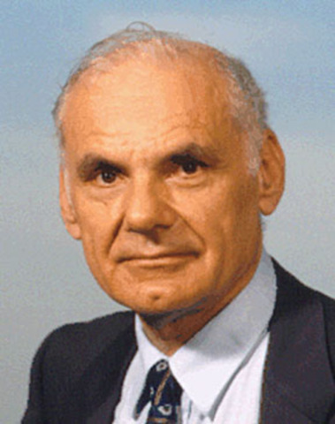
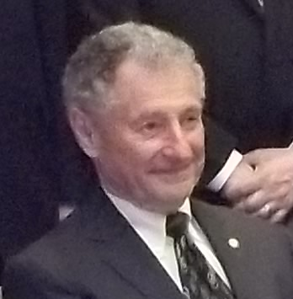
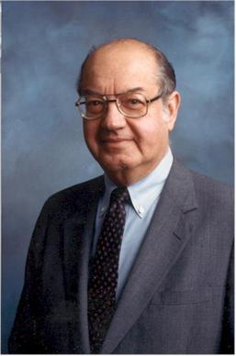
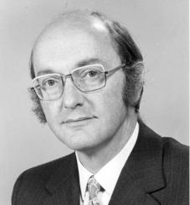
Packet Switching Pioneers
Larry Roberts, Leonard Kleinrock, Paul Baran, Donald Davies

Slide 11
Larry Roberts
Program manager at the Advanced Research Projects Agency
Led team that created the ARPANET

Slide 12
Leonard Kleinrock
Managed UCLA software team, including Steve Crocker, Vint Cerf, and Jon Postel
1962 Ph.D. thesis on queueing theory

Slide 13
Paul Baran
1959: RAND Corporation
  Design of a “survivable” communications system
Packet switching: “message blocks”
“On Distributed Communications”

Slide 14
Donald Davies
National Physical Laboratory in the United Kingdom
Packet switching: “packets”
  Translatable into other languages

Slide 15
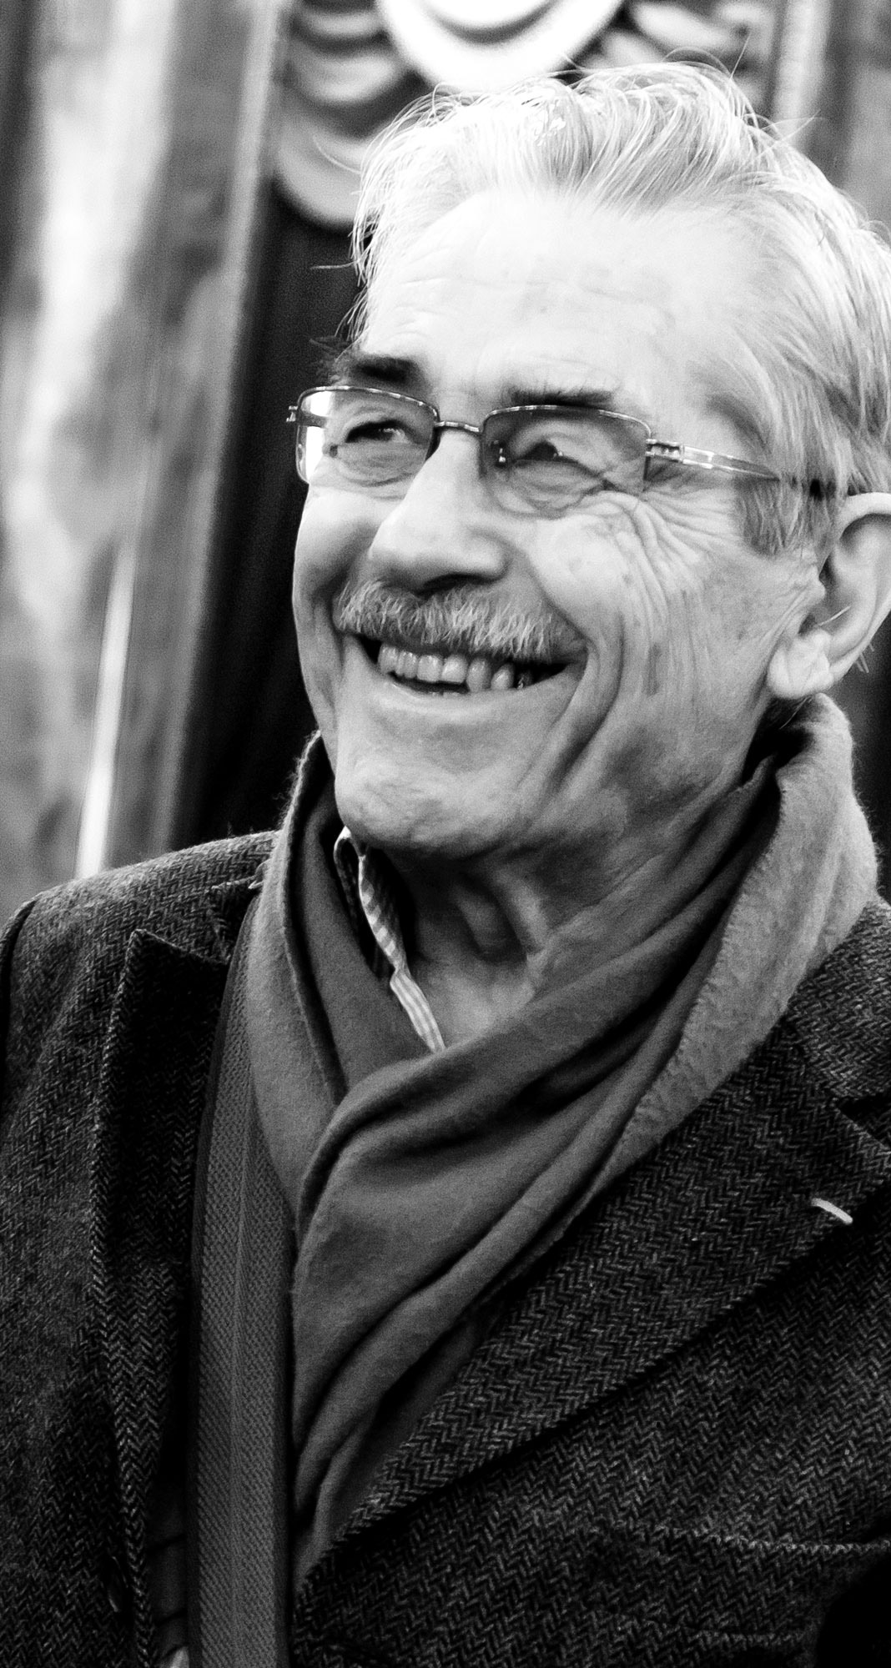
Louis Pouzin
CYCLADES packet communication network
  First actual implementation of the pure datagram model

Slide 16
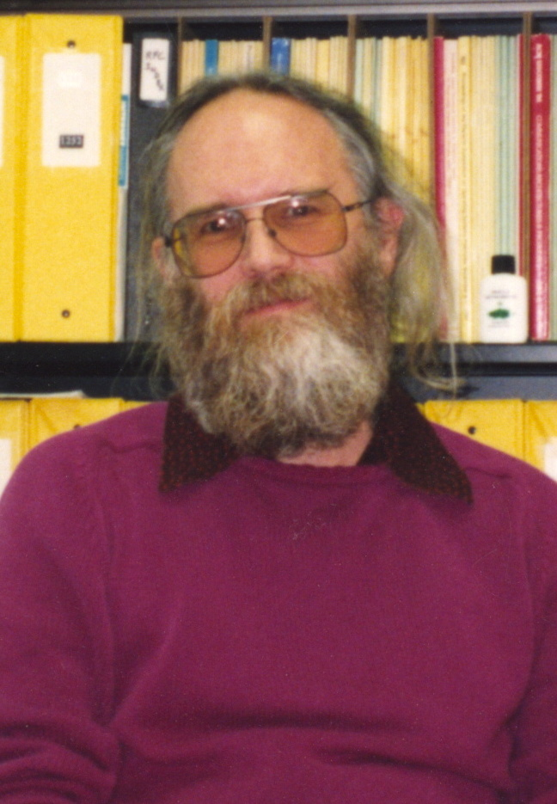
Jon Postel
“The god of the internet”
1969 – 1998: Editor of the Request for Comment (RFC) document series
Simple Mail Transfer Protocol (SMTP)
DNS
Administrator of Internet Assigned Numbers Authority (IANA)
Postel’s Law: “Be conservative in what you send, be liberal in what you accept”

Slide 17
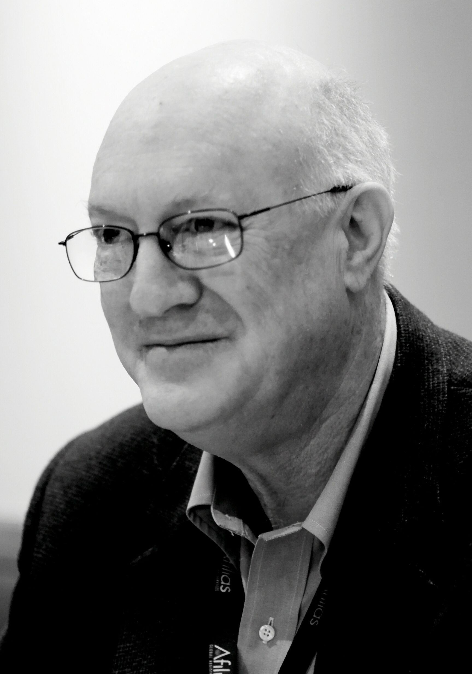
Steve Crocker
1969: RFC 1: Host Software
1969: Created the ARPA “Networking Working Group”
2011 – 2017: chair of the board of the Internet Corporation for Assigned Names and Numbers (ICANN)
Internet Engineering Task Force (IETF) security area director
Internet Architecture Board
Internet Society Board

Slide 18

Radia Perlman
“Mother of the Internet”
1985: Spanning-Tree Protocol (STP)
Transparent Interconnection of Lots of Links (TRILL)
More than 100 patents
Multiple RFCs

Slide 19
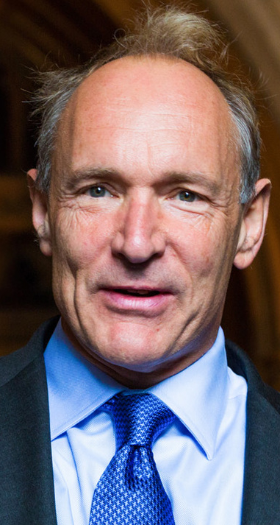
Tim Berners-Lee
1989: Hypertext Transfer Protocol (HTTP)
1990: First web site, at CERN
1994: founded World Wide Web Consortium (W3C)
2009: co-founded the World Wide Web Foundation
Time magazine’s list of the 100 Most Important People of the 20th century
Net neutrality advocate
2017: Accepted Encrypted Media Extensions (EME) proposal
  Digital Rights Management (DRM)

Slide 20
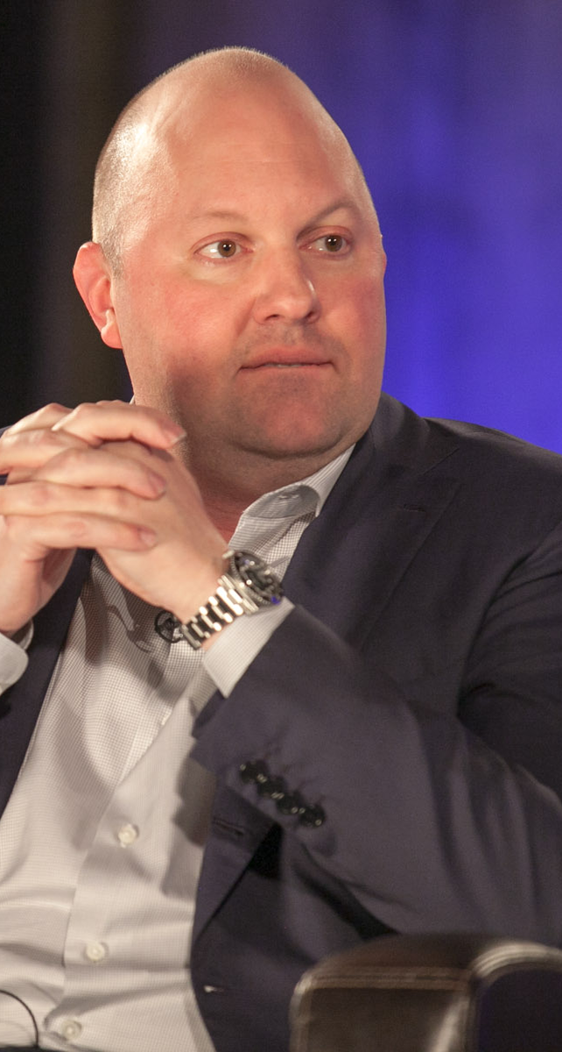
Marc Andreessen
Mosaic Communications Corporation co-founder and vice president of technology
1993: NCSA Mosaic web browser

Slide 21
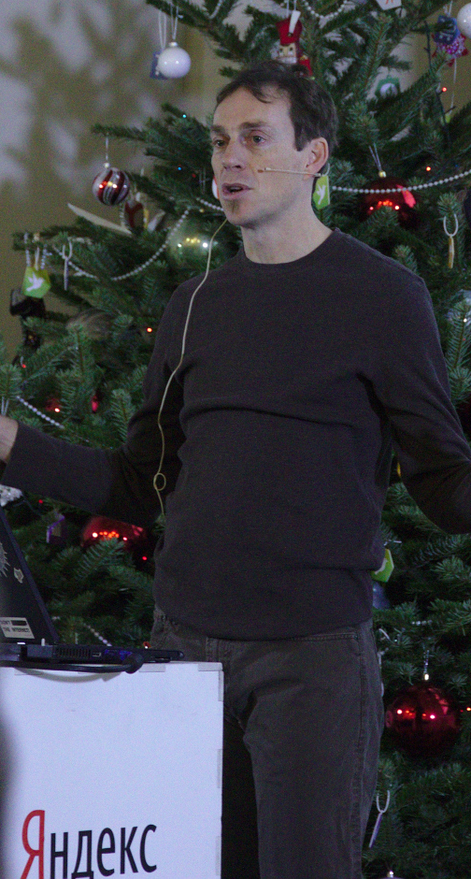
Theo de Raadt
1993: Co-founder of NetBSD
1995: Founder of OpenBSD
1999: OpenSSH

Slide 22
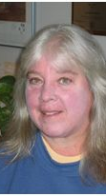
Joyce Reynolds
1993 – 1998: Worked with Jon Postel developing Internet Assigned Numbers Authority (IANA)
1998 – 2001: Helped transition IANA functions to the Internet Corporation for Assigned Names and Numbers (ICANN)
1987 – 2006: Request for Comments (RFC) editorial team
RFCs
  Telnet
  FTP
  POP

Slide 23
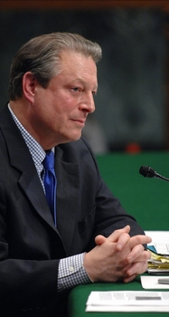
Al Gore
No, he didn’t invent the Internet, but he helped
1980s – 1990s: promoted legislation to fund ARPANET expansion, public access
1986: S 2594, Supercomputer Network Study Act of 1986
1991: High Performance Computing and Communication Act of 1991 (“The Gore Bill”)
Helped fund National Center for Supercomputing Applications (NCSA)
Quoted out of context as claiming to have invented the Internet
  “I took the initiative in creating the Internet.”

Slide 24
Internet Timeline
Pre-1980
1948: Claude Shannon: “A Mathematical Theory of Communication”
1968: J.C.R. Licklider: “The Computer as a Communication Device”: computer networks
1969: Steve Crocker: RFC 1: Host Software
1969: Leonard Kleinrock: first message on the ARPANET
  “l”, “o”, <crash>; later, “login”
1973: TCP draft standard
1975: connect Stanford to BBN in Cambridge Mass and University College London (not a success)
1979: Tom Truscott and Jim Ellis (Duke University): Usenet

Slide 25
Internet Timeline
1980s
1981: Computer Science Network (CSNET) for institutions that could not connect directly to ARPANET
1983: DNS
1986: IETF formed, from predecessor Gateway Algorithms and Data Structures (GADS) Task Force
1980s – 1990s: Al Gore: promoted legislation to fund ARPANET expansion, greater public access
1986: Al Gore introduced S 2594, Supercomputer Network Study Act of 1986
1986: NSFNET project
1989: commercial ISPs emerge
1989 – 1990: Tim Berners-Lee: HTTP, first web site (CERN)

Slide 26
Internet Timeline
1990s
1990: ARPANET decommissioned
1991: CUUG formed
1991: High Performance Computing and Communication Act of 1991 (“The Gore Bill”)
1992: Internet Society (ISOC): home of IETF, IAB, IESG, IRTF
1994: Tim Berners-Lee: founded World Wide Web Consortium (W3C)
1995: optical backbone of NSFNET decommissioned
  Sprint, MCI and AT&T optical networks; commercial traffic OK
1998: Morris worm
1998: IPv6 draft standard
1999: IANA project transferred USC (Jon Postel) to ICANN

Slide 27
Internet Timeline
21st Century
2000s: IoT devices surpassed the number of humans alive at some point in the late 2000s
2008: NASA conducted field test of “deep space internet”
2009: Tim Berners-Lee: co-founded the World Wide Web Foundation
2010: first Internet link into low Earth orbit: T. J. Creamer Twitter update from the International Space Station
2011: last available IPv4 address assigned
2017: Tim Berners-Lee: Encrypted Media Extensions (EME) proposal: W3C recommendation

Slide 28
Significant RFCs
1969: RFC 1: Host Software (Steve Crocker)
1974: RFC 675: SPECIFICATION OF INTERNET TRANSMISSION CONTROL PROGRAM (Vinton Cerf, Yogen Dalal)
1981: RFC 791: INTERNET PROTOCOL (Postel)
  RFC 792: INTERNET CONTROL MESSAGE PROTOCOL (Postel)
  RFC 793: TRANSMISSION CONTROL PROTOCOL (Postel)
1982: RFC 819: The Domain Naming Convention for Internet User Applications (Za-Sing Su, Postel)
  RFC 819, RFC 881, RFC 882 and RFC 920
1983: RFC 883: The Domain Names Plan and Schedule (Postel)
1984: RFC 920: Domain Requirements (Postel, Reynolds)

Slide 29
Less-Significant RFCs
April 1
1990: RFC 1149: A Standard for the Transmission of IP Datagrams on Avian Carriers
1991: RFC 1217: Memo from the Consortium for Slow Commotion Research (CSCR) (Cerf)
1994: RFC 1607: A VIEW FROM THE 21ST CENTURY (Cerf)
  actual historical background of Internet
1999: RFC 2549: IP over Avian Carriers with Quality of Service
2003: RFC 3514: The Security Flag in the IPv4 Header
2011: RFC 6214: Adaptation of RFC 1149 for IPv6
2014: RFC 7168: The Hyper Text Coffee Pot Control Protocol for Tea Efflux Appliances (HTCPCP-TEA)

Slide 30
Trivia
Van Nuys High School, Los Angeles
Vint Cerf
Jon Postel
Steve Crocker

Slide 31
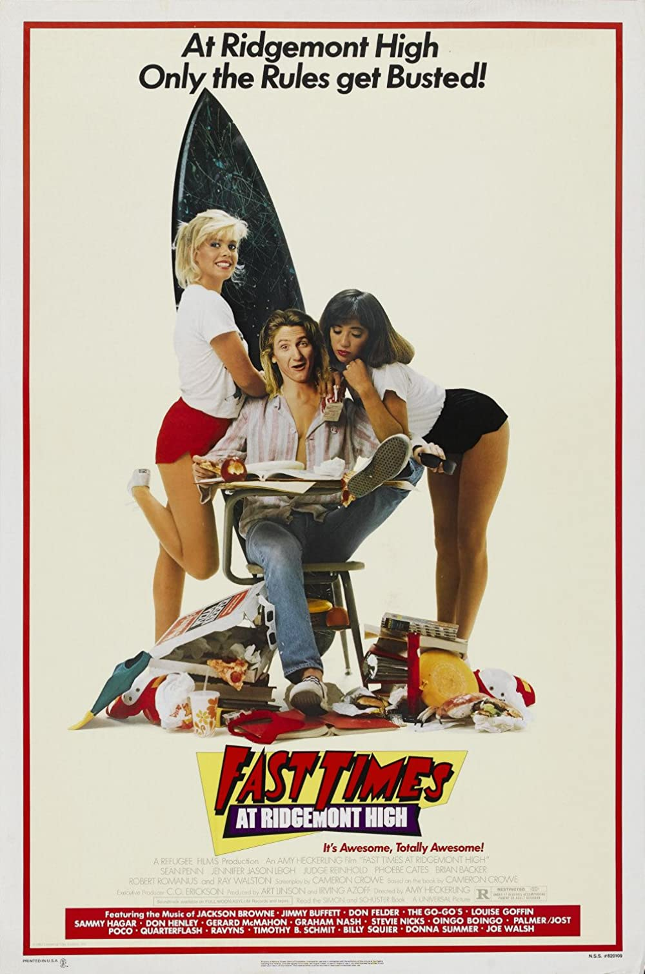

Trivia
Van Nuys High School, Los Angeles

Slide 32
Your Internet Recollections
What have I missed?

Slide 34

















Image Credits
Vint Cerf: By Duncan.Hull - Own work, CC BY-SA 4.0, Link
Bob Kahn: By Вени Марковски | Veni Markovski - Own work, CC BY-SA 3.0, Link
Claude Shannon: By Jacobs, Konrad - CC BY-SA 2.0 de, Link
J. C. R. Licklider: By Unknown author - Public Domain, Link
Larry Roberts: By Unknown author - CC BY-SA 4.0, Link
Leonard Kleinrock: By Brewster Kahle - Personal camera, Public Domain, Link
Paul Baran: By Paul Baran, Fair use, Link
Donald Davies: By Unknown author - Fair use, Link
Louis Pouzin: By Jérémie Bernard - Own work, CC BY-SA 3.0, Link
Jon Postel: By Carl Malamud - Flickr: Jon Postel, CC BY 2.0, Link
Steve Crocker: By Joi Ito - Flickr, CC BY 2.0, Link
Radia Perlman: By Scientist-100 at English Wikipedia - Transferred from en.wikipedia to Commons., Public Domain, Link
Tim Berners-Lee: By Paul Clarke - Own work, CC BY-SA 4.0, Link
Marc Andreessen: By JD Lasica - CC BY 2.0, Link
Theo de Raadt: By FAndrey - CC BY 2.0, Link
Joyce Reynolds: https://icannwiki.org/images/1/16/Joyce_Reynolds.JPG
Al Gore: By U.S. Senate Committee on Environment and Public Works - Public Domain, Link

